Slide 1


AGROTECH
COMPANY PROFILE
presented by:
Sumit
Yuvraj
Maharshi

Slide 2




Problem statement
03
Indian farmers face challenges like unpredictable weather, water scarcity, high input costs, and poor market access. Limited credit options and lack of modern technology further reduce productivity and profitability. Addressing these issues is vital for sustainable agriculture and improving farmer livelihoods.

Slide 3
03
PROBLEMS FACED BY FARMER, TOLD IN INTERVIEW
1. Unpredictable Weather Patterns
2. Lack of Irrigation Facilities
3. Soil Degradation
4. High Input Costs
5. Limited Access t
6. Poor Market Accesso Credit
7. Post-Harvest Losses
8. Pest and Disease Infestations
9. Lack of Modern Technology
10. Fragmented Land Holdings
11. Lack of Education and Training
12. Crop Insurance and Risk Management

Slide 4
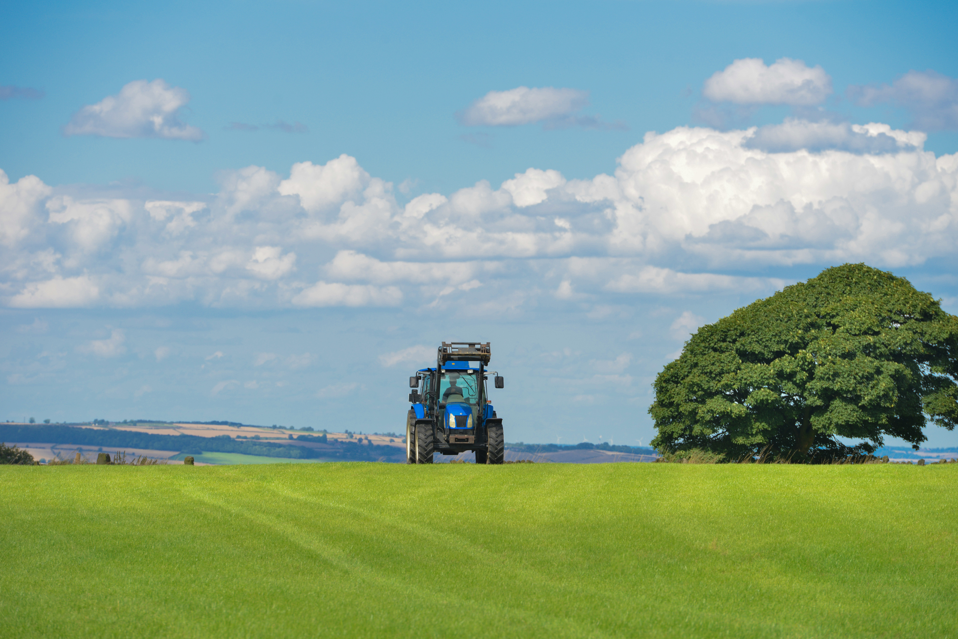
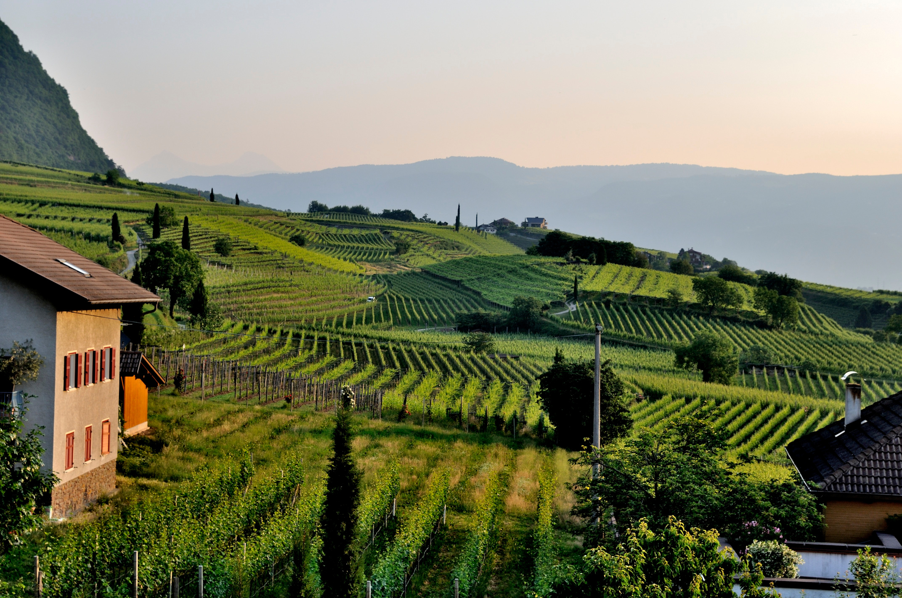

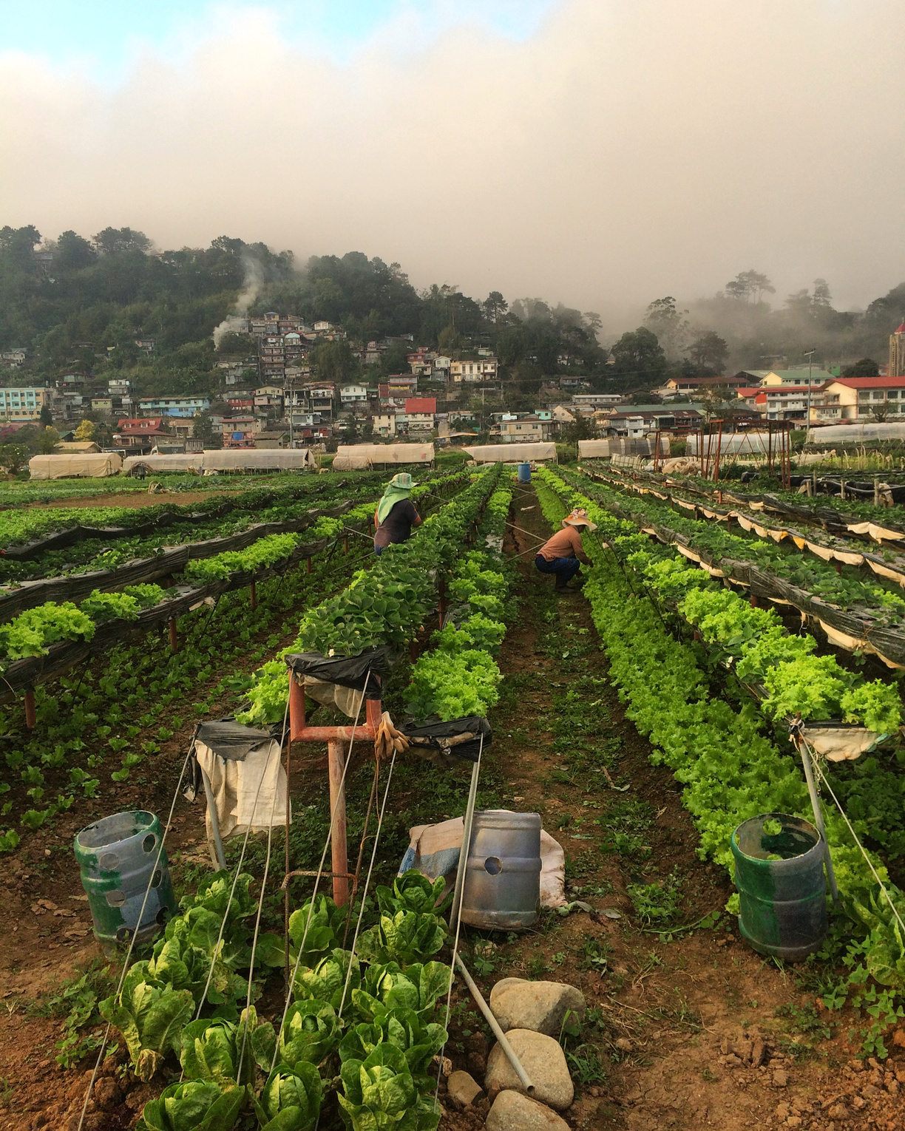
03
Our Products
Agrotech offers a diverse range of agricultural products, including insurance, seedlings, tech to improve crops and give platform to farmer for marketing

Slide 5

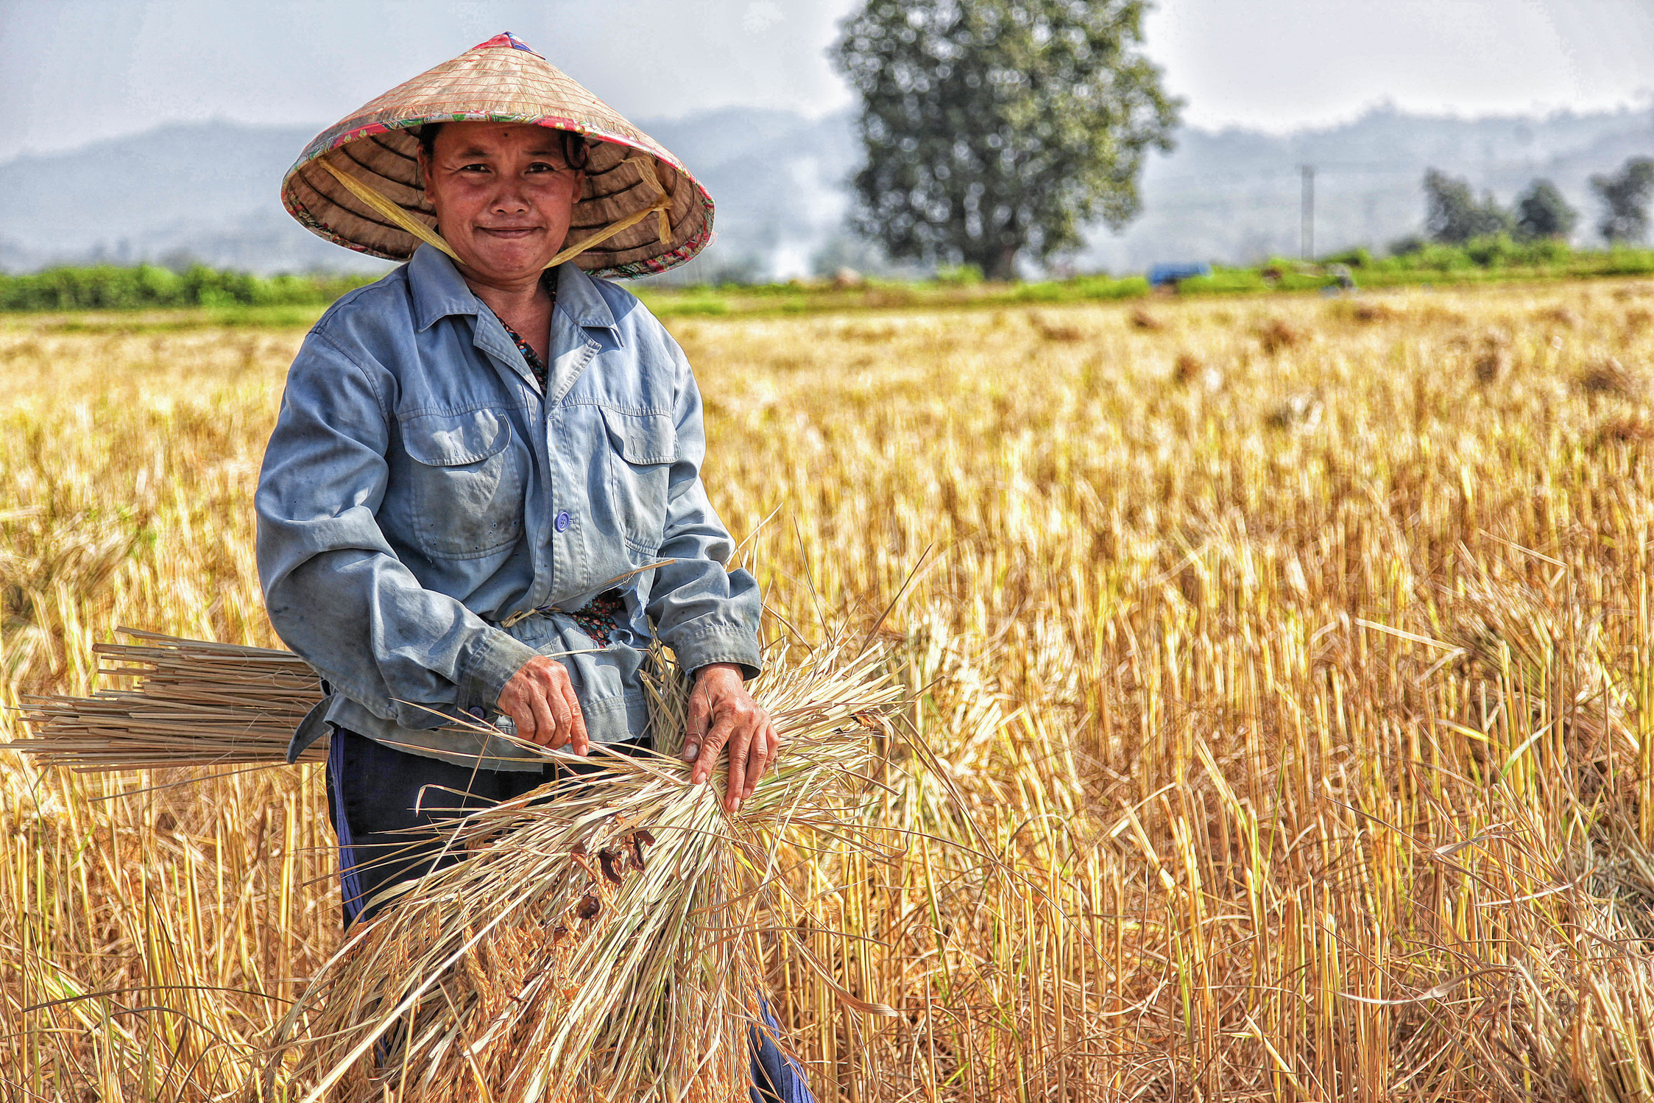

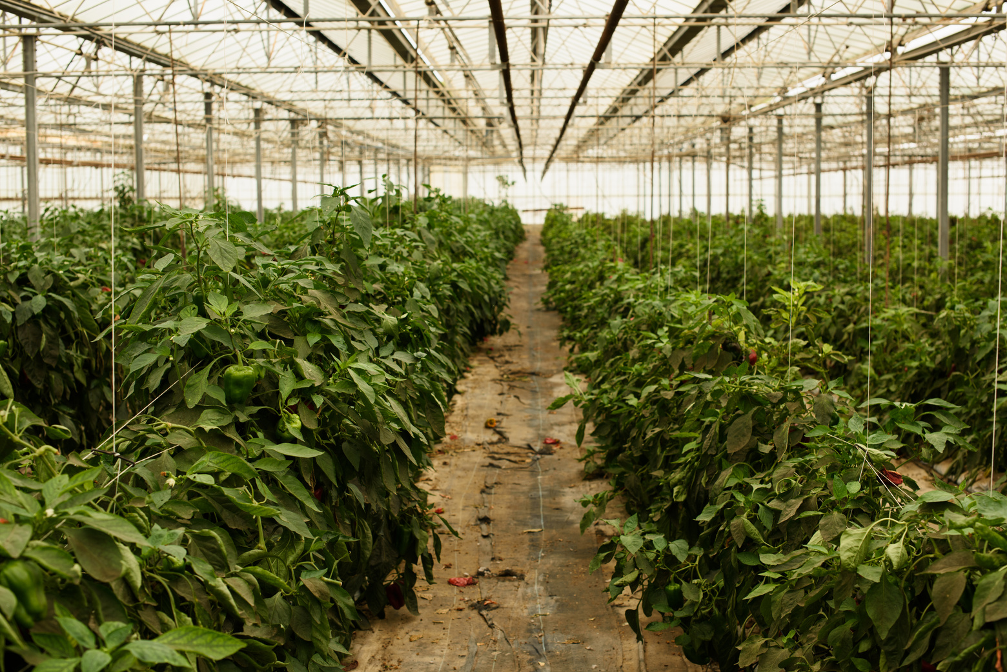
04
Sustainable Practices
At Agrotech, we are committed to practicing sustainable agriculture by minimizing environmental impact, conserving natural resources, and promoting biodiversity. We employ techniques such as crop rotation, integrated pest management, and precision agriculture to ensure the long-term viability of farms.

Slide 6
Technology in Agriculture
Soil Health Monitoring: Analysis of soil nutrient levels and recommendations for soil
enhancement.
• Precision Farming: Use of satellite imagery and sensors to monitor crop health, water levels,
and optimize inputs.
• Pest and Disease Control: Early detection of pests and diseases using AI-based applications
and drones.
• Water Management Solutions: Implementation of drip irrigation and smart water usage
systems.
• Training &amp; Support: On-field and online training programs for farmers to adopt best
practices in farming.
• Precision Farming: Use of satellite imagery and sensors to monitor crop health, water levels,
and optimize inputs.
08

Slide 7
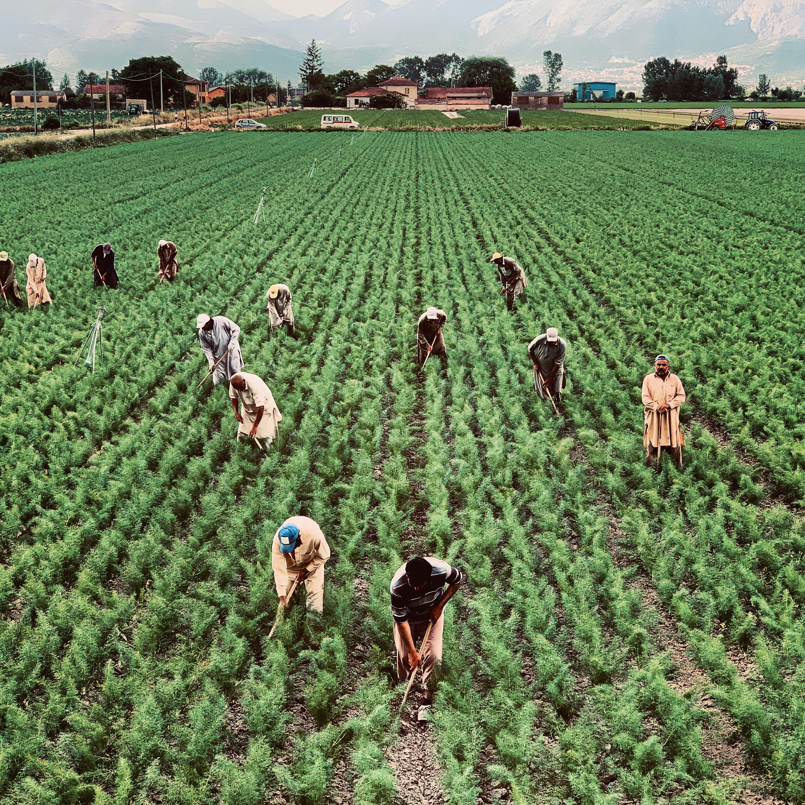
06
Quality Assurance
We prioritize quality assurance at every stage of the production process, from seed selection to harvesting and packaging. Our stringent quality control measures ensure that only the finest products reach our customers.

Slide 8
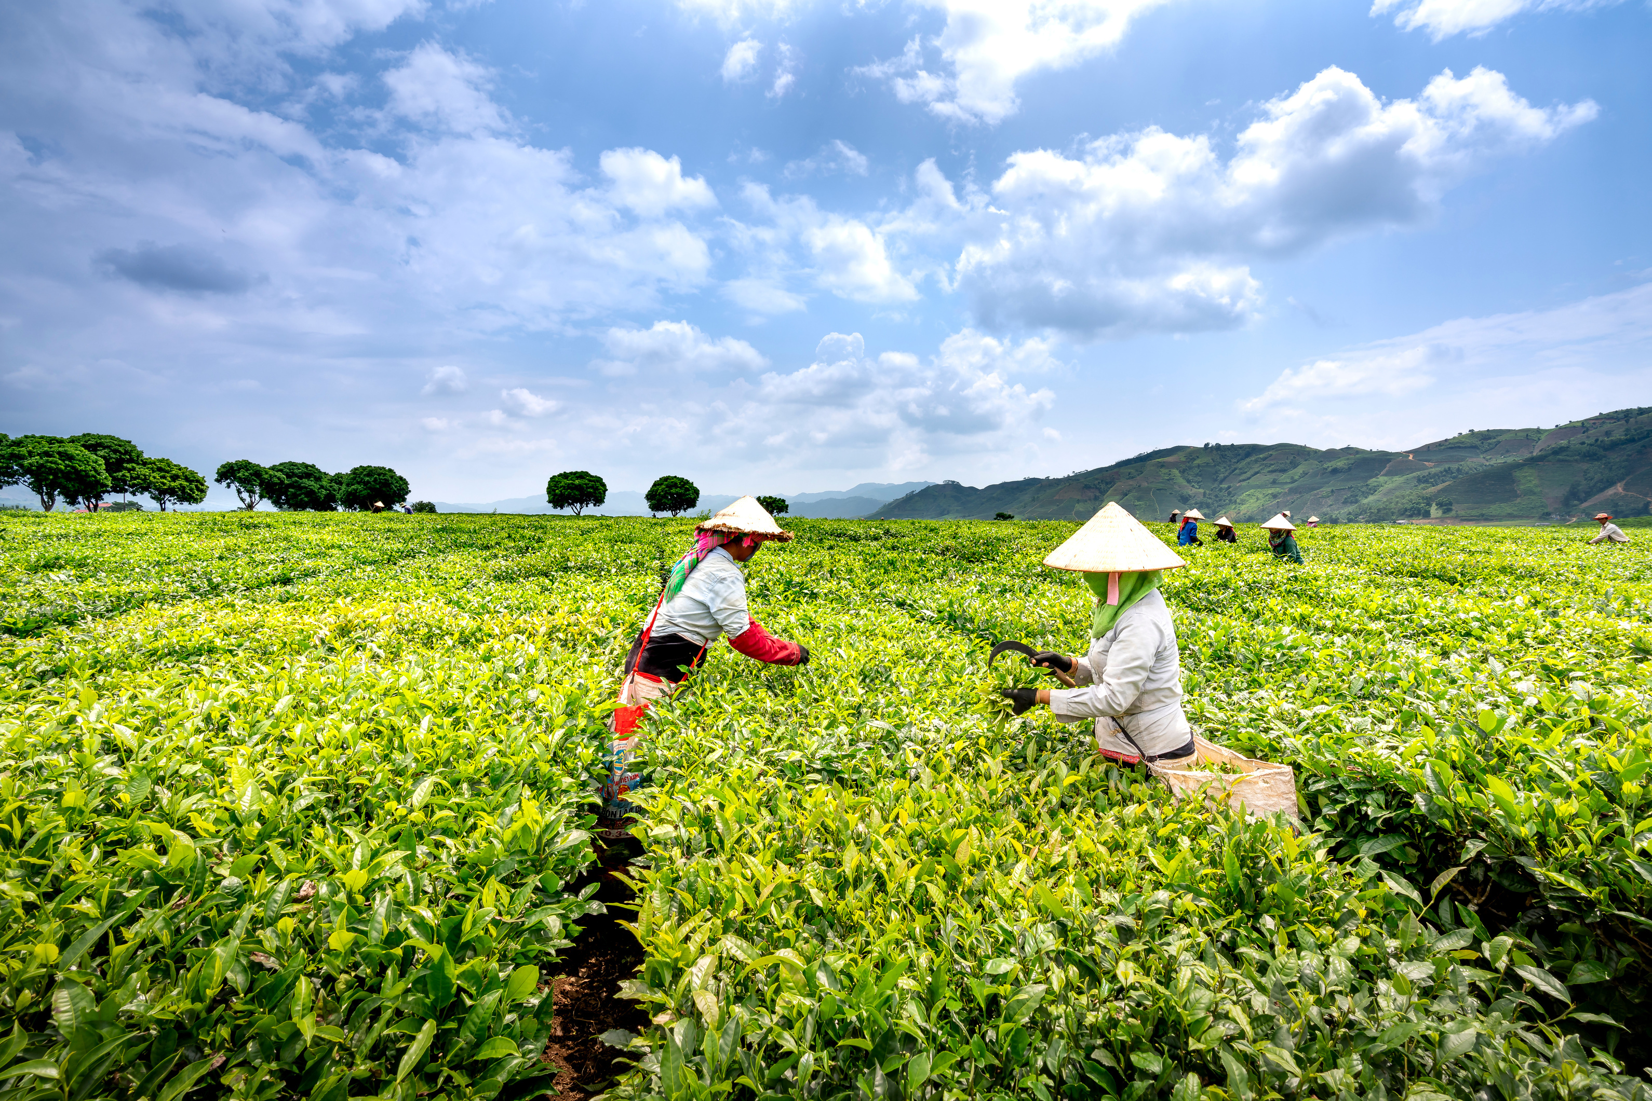
Market Expansion
07
Domestic Growth
International Expansion
New Product Development
Agrotech aims to strengthen partnerships with retailers and distributors, leveraging targeted marketing strategies to increase brand visibility and capture a larger share of the domestic market. We tailor product offerings to meet evolving consumer demands.
We conduct thorough market research to identify opportunities for expansion in key global markets. By establishing partnerships with local distributors and adhering to sustainability practices, we introduce our high-quality agricultural products to international consumers.
Agrotech invests in innovative crop varieties to diversify our product portfolio and meet emerging consumer trends. Collaborating with agricultural experts, we create products that offer unique flavors, nutrition, and environmental resilience.

Slide 9

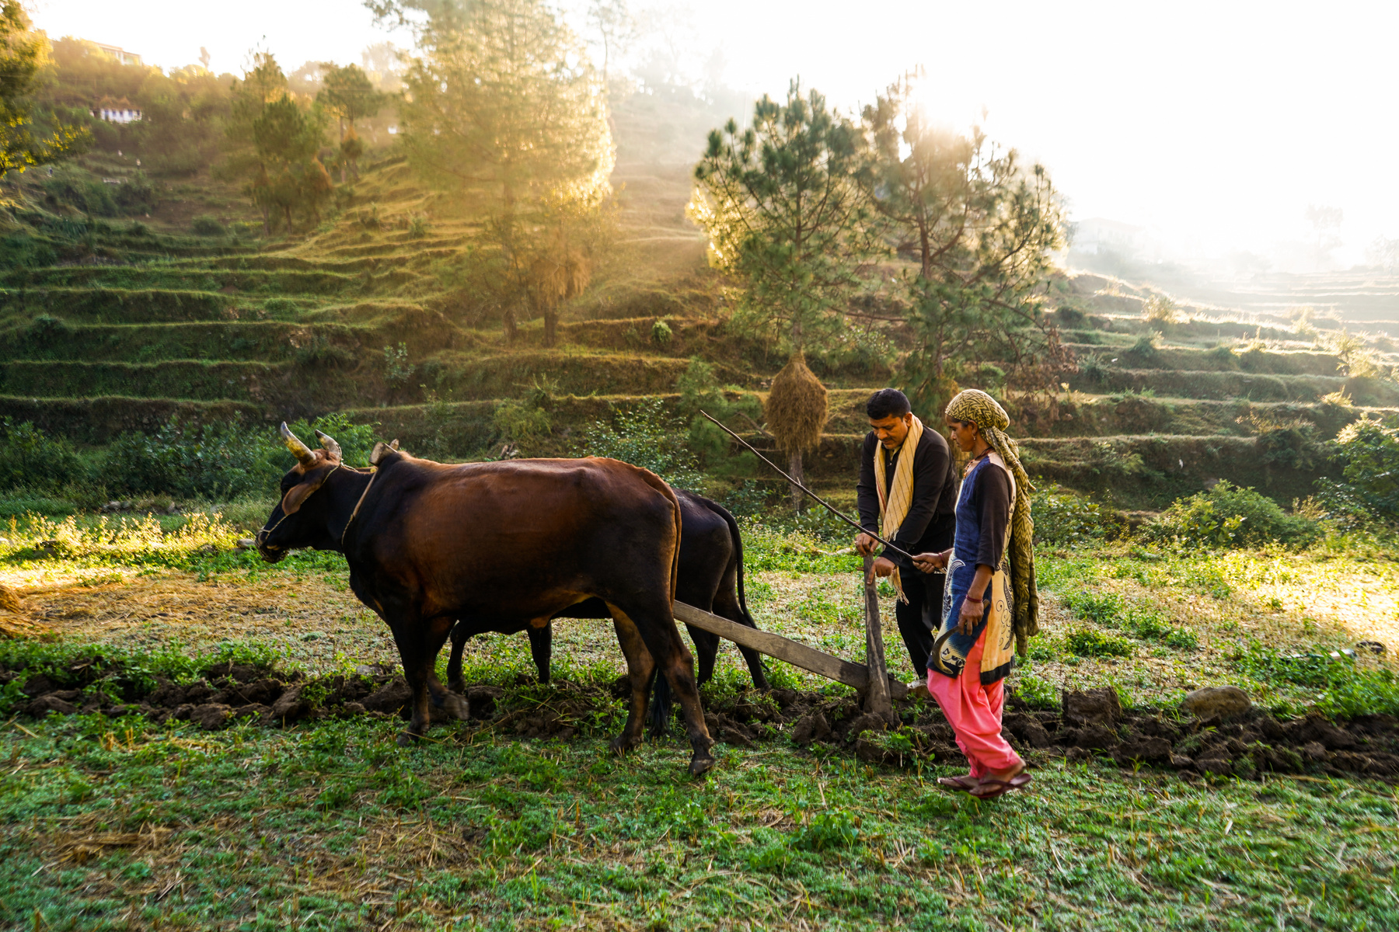
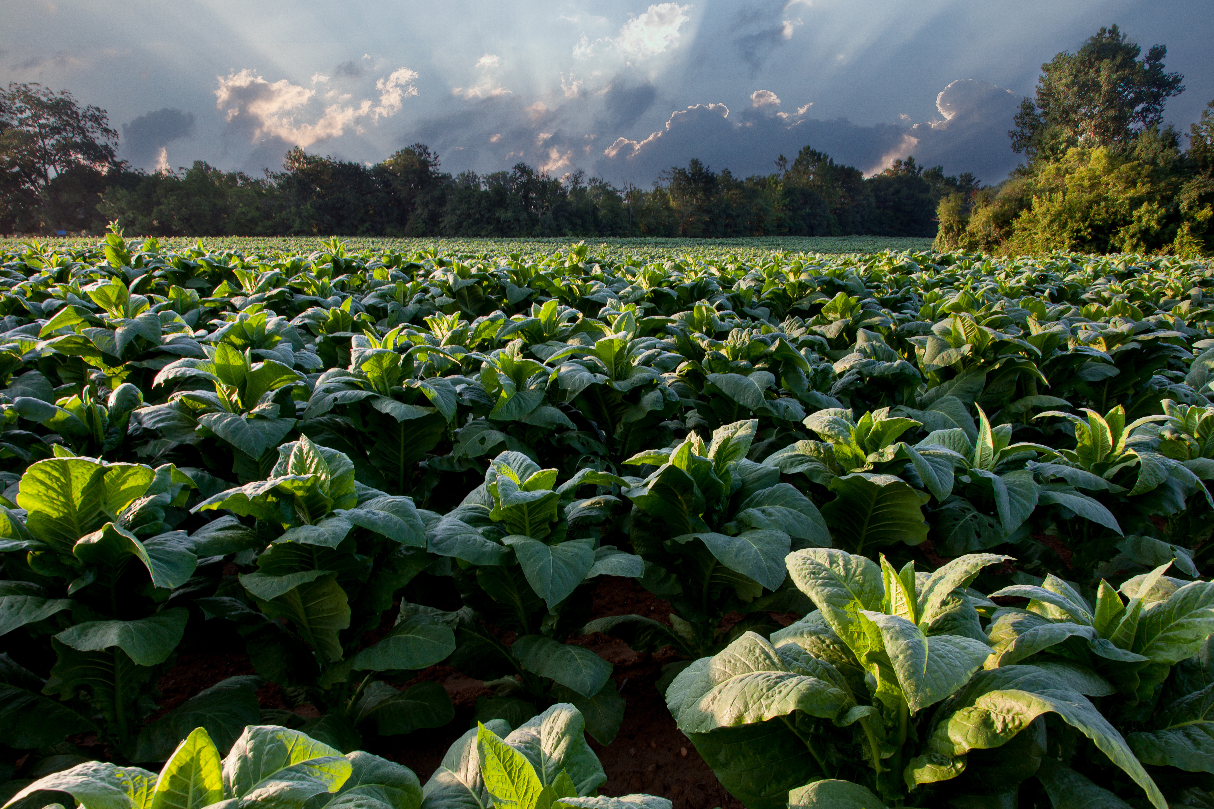

09
Future Growth
As we look to the future, Agrifarm is poised for continued growth and innovation. We remain committed to advancing sustainable agriculture practices, exploring new markets, and delivering value to our customers.

Slide 10







09
Research on marketing conditions in agriculture
Talked to industry experts about project
Interviewed farmers
Researched all the neccessary solutions .
Visited Agri related shops to get to know about pesticides and seeds and equipments
Made a website

Slide 11

Thank You!

